Slide 1
Book Genre Classification from Synopsis Text
MSI5001
Michael Merriot Sasmita,
Rini Pinasthika,
Tan Tit Ho,
Teong Wei Kok

Slide 2
Agenda
Problem Definition & Project Objective
Methodology & Approach
Dataset Overview and Pre-Processing
Models Training, Evaluation and Results
  Logistic Regression + TF-IDF
  DistilBERT + Contextual Embeddings
Insights & Learnings
Conclusion

Slide 3
Problem Definition
Task Objective:
To classify each book into its respective genre based on the synopsis (e.g., Fantasy, Science, Crime, History, Horror, Thriller, Psychology, Romance, Sports, Travel).
Problem Context:
Book synopsis provide short, descriptive summaries that contain genre-specific language cues. Classifying books into genres using synopses enables automatic cataloging, improved recommendations, and easier search for users—benefitting digital libraries, bookstores, and content providers
Notes:
The model must handle noisy or ambiguous synopses, missing or inconsistent genre labels, and highly imbalanced class distributions.
The approach should maximize precision and recall across all genres, including rare or overlapping categories.

Slide 4
Methodology & Approach
AI System Development Pipeline
Problem Framing
Data Collection
Data Preprocessing
Model Selection
Model Training
Model Validation
Model Evaluation
Deployment
Monitoring and Feedback
Approach
Initial evaluation based on 3 different AI models
Pick 2 most promising models to expand
Iterate steps 3 to 7 until we get optimal results
Compare and evaluate the 2 models vs objective
Evaluation
Scenario A: User inputs a book synopsis; the model must correctly identify its genre → high Precision is crucial.
Scenario B: User browses books by genre and prefers not to miss any relevant ones → high Recall is more important.
To balance both use cases, we use weighted F1-Score as the main evaluation metric across all 10 genres.

Slide 5
Our Three-Model Strategy
Methodology
Model | Input Representation | Strength | Typical F1 / Accuracy (estimate)
Logistic Regression | TF-IDF | Simple baseline | ~65–75%
XGBoost + fastText | Word embeddings | Captures semantics | ~75–85%
DistilBERT | Contextual embeddings | Captures deep meaning | ~85–95%

Slide 6
Data Collection and Preprocessing
The study uses a dataset of 4,657 book synopses labeled by genre, facing significant class imbalance. Rigorous exploratory data analysis and cleaning steps were applied to ensure high-quality inputs, followed by advanced preprocessing tailored for text classification tasks.
1
Dataset Overview
•Utilizes Data.csv with 4,657 book synopses and genre labels.
2
Visual inspection performed using Excel and text editors.
Analyzed genre frequency & distribution.
Dataset covers 10 genres with a high class imbalance (ratio 10.2:1). Class imbalance poses challenges for model training and evaluation.
Identified anomalies such as duplicates, nonsensical words, irrelevant contents, missing entries, and skewed synopsis lengths (Filter for length between 3 to 20 characters), but not truncated to preserve information.
Inspected word counts per-synopsis for potential outliers or overly short/ long entries.
Exploratory Data Analysis
3
Data Cleaning
Removed duplicates and empty summaries to ensure data quality.
Filtered out irrelevant content like URLs, emails, and HTML tags.
Eliminated nonsensical words to maintain meaningful input for modeling.
4
Preprocessing Techniques
Addressing Imbalance Datasets with SMOTE
Applied lemmatization to standardize word forms.
Filtered word lengths to include only 3-20 character words.
Performed text vectorization for Logistic Regression.
Did not truncate synopses despite length skew to retain context.
Notes:
Dataset Description & Source
Dataset Content: The dataset comprises book synopses, each associated with a genre label.​
Objective: The task is to classify each book into its respective genre using only the synopsis text.​
Genres Included:
Fantasy
Science
Crime
History
Horror
Thriller
Psychology
Romance
Sports
Travel
Each genre is mapped to an integer label from 1 to 10.​
Source: Provided as a CSV file with two core fields: synopsis (string) and genre (integer).​
Data Structure & Format
Structure:
Each row represents a single book.
Fields:
synopsis (raw text description of the book)
genre (numerical code, 1–10)​
Distribution:
Genres are highly imbalanced; some genres (like fantasy, history, thriller) are much more prevalent than others.​
Training/Test Split:
Recommended split: 80% for training, 20% for testing.
5-fold cross-validation should be performed on the training data for robust model selection.​
Data Quality: Anomalies & Challenges
Missing Values: Some synopses may be missing or blank, requiring removal or imputation.​
Duplicates: Dataset may contain duplicate entries needing detection and elimination for model clarity.​
Text Anomalies:
Several synopses include nonsensical words or irrelevant content (such as URLs, emails, HTML, or random character sequences).​
Preprocessing is necessary to clean these anomalies and standardize the dataset for effective modeling.​
Class Balance
Imbalance: Major genres have much higher representation, while minor genres have only a few samples (imbalance ratio can exceed 10:1 between most/least frequent classes).
Implications:
Imbalance impacts model training and evaluation; requires balancing techniques such as SMOTE for classical models or class weighting for neural models.​
Data Insights & Preparation
Exploratory Analysis Needed:
Analyze genre frequency and distribution.
Inspect word counts per synopsis for potential outliers or overly short/long entries.
Identify and remove irrelevant or low-quality entries.
Representative Examples:
Review a random sample of synopses across genres to verify label consistency and text usefulness.
Because of the time limitation, we will not further describe each of the findings but we

Slide 7
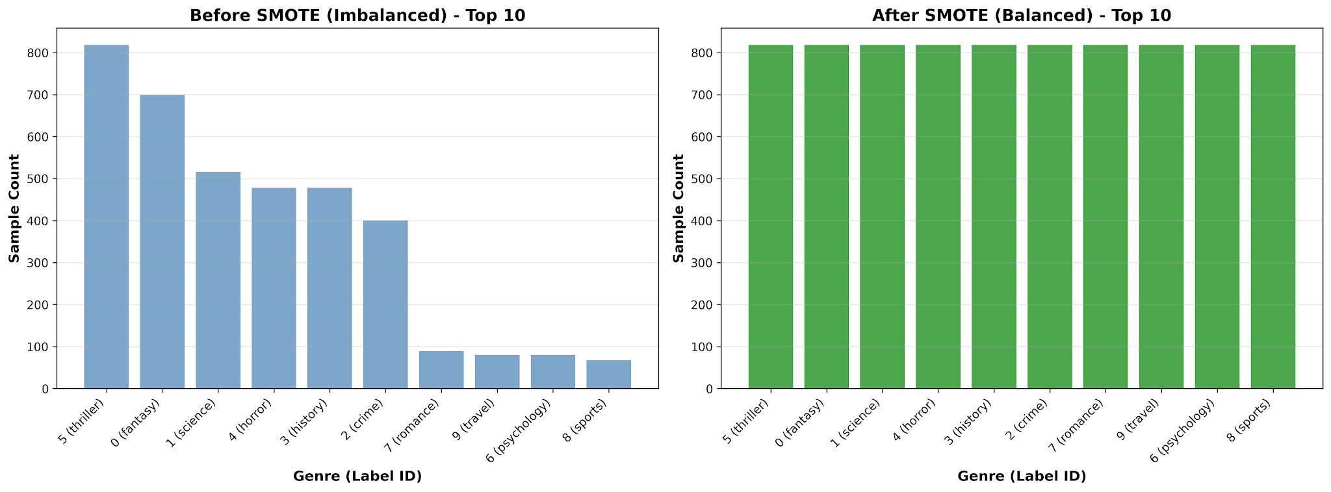
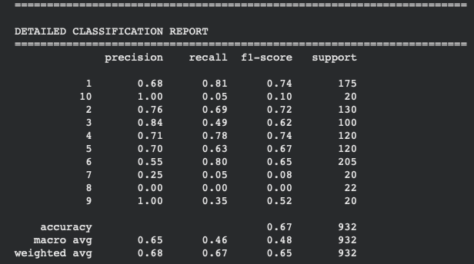
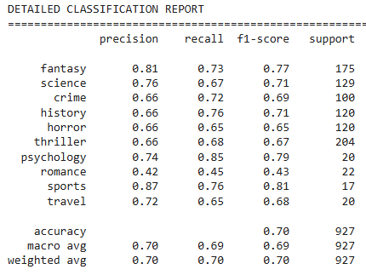
Addressing Imbalance Datasets with SMOTE
Addressing Imbalanced Datasets
When working with imbalanced datasets, overall accuracy can be misleading.
A model might achieve high accuracy by predicting the majority class, failing to identify the critical minority class.
Techniques like SMOTE address this issue.
These strategies ensure the model performs well across all classes, improving real-world effectiveness.

Slide 8
Preprocessing Pipeline
Methodology
 | Stage 1 Data Cleaning | Stage 2 Normalization | Stage 3 Feature Extraction
Logistic Regression | Lowercase conversion Remove URL Remove non-alphanumeric Remove | Using NLTK for tokenization Remove common stopwords Lemmatization + POStagging | Apply TF-IDF for vectorization Use unigram & bigram Select top K feature to reduce dimensionality
XGBoost + FastText | Lowercase conversion | Using FastText built-in tokenization Keep common stopwords
distilBERT | Without lowercase conversion | Use distilBERT Tokenizer Keep common stopwords Without Lemmatization | Text-to-ID conversion maps each token to its vocabulary index
Notes:
The more advanced the model, we dont need to have more thorough preprocessing
We follow the 3 specific stages for each model. Its different from each of the model.

Slide 9
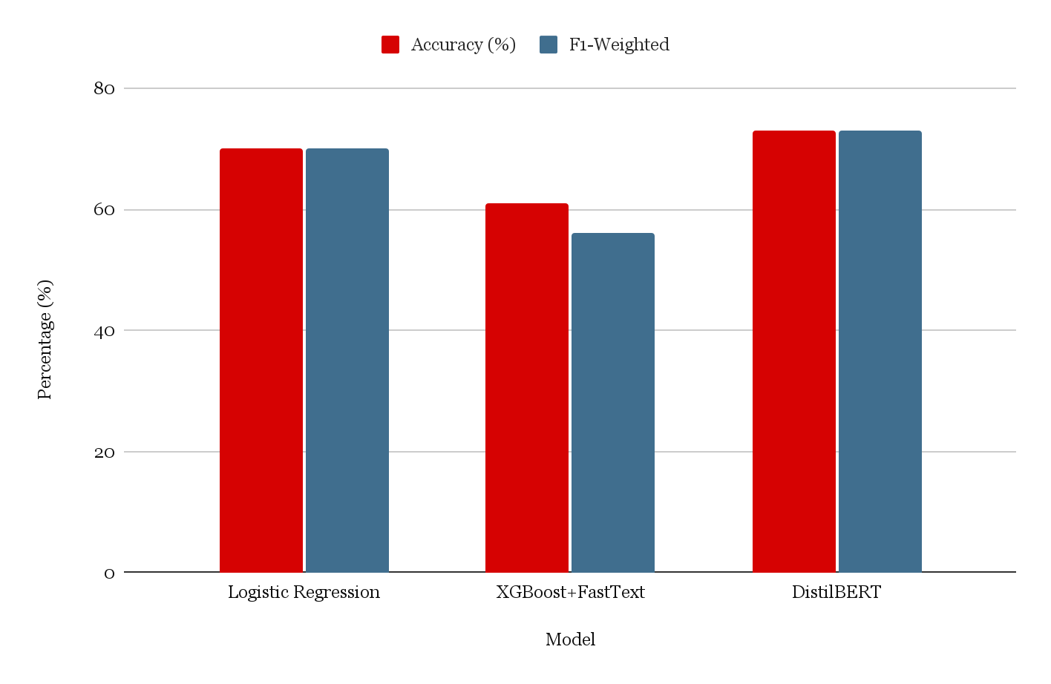
Performance Comparison
Results
Accuracy & F1-Weighted Comparison:
LogReg vs XGBoost vs DistilBERT
Detailed Performance Metrics
Logistic Regression achieves 70% F1-Weighted, which is our baseline model.
DistilBERT attains 74% F1-Weighted, a 4% improvement over Logistic Regression, but with increased computational expense.
XGBoost achieves 61% F1-Weighted. Its extended training time prohibits further fine-tuning within the project's limited timeline.
DistilBERT's failure to achieve a higher score in this instance is attributed to the limited training samples. To surpass Logistic Regression, it requires a minimum of 1000 samples per class.
We will only cover LogReg vs DistilBERT for further analysis

Slide 10
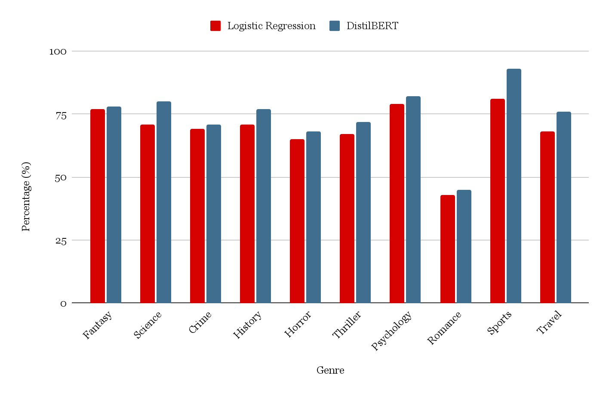
Where Each Model Excels and Struggles
Result
Genre-wise F1-score Comparison: Logistic Regression vs DistilBERT
Scenario | LogReg Reasoning | DistilBERT Reasoning
Pure Psychology | Finds technical words like "therapy," "behavior" | Understands cause-effect ("trauma → anxiety")
Sports Book | Spots action words: "game," "team," "athlete" | Grasps Sequence: train → compete → win
Fantasy- Romance | Sees "sword," "magic" (stronger) vs "love" (weaker); guesses Fantasy | Reads main narrative(fantasy journey); misses sub plot (romance); guesses Fantasy
Horror vs Thriller | Can't distinguish because both use "murder," "suspense" | Both have dark context; structure too similar; guesses wrong
Multi-Genre | Keyword dominance determines guess;lower confidence | Narrative dominance determines guess;over confident

Slide 11
Logistic Regression vs DistilBERT
Insight - Model
Models | Strengths | Weakness
Logistic Regression - The Keyword Detective - “Thinks in keywords” | Fast and resource efficient Effective imbalance handling Strong baseline performance Interpretable | Bag-of-words approach Semantic blindness Linear underfitting
DistilBERT - The Story Understander - “Thinks in stories” | Contextual understanding Efficient architecture Best overall performance Deep semantic processing | Resource intensive Limited interpretability Small dataset constraints Truncation information loss

Slide 12


Examples - Log Reg (Success)
Insight - Model: Logistic Regression
Example 1 - Fantasy Genre
Example 2 - Psychology Genre
TF-IDF measures word significance by calculating term frequency × inverse document frequency
Psychology genre has highly distinctive technical vocabulary

Slide 13


Examples - Log Reg (Misses)
Insight - Model: Logistic Regression
Example 1 - Hybrid Fantasy-Romance
Example 2 - Thriller/ Horror Confusion
Fantasy-specific technical terms dominate the feature space when they co-occur with Romance language
Shared vocab creates overlapping TF-IDF features

Slide 14


Examples - DistilBERT (Success)
Insight - Model: DistilBERT
Example 2 - Differentiating Thriller/ Horror from Psychological
Example 1 - Fantasy
Bidirectional attention captures narrative structure and mythological context
Understands casual relationships

Slide 15


Examples - DistilBERT (Misses)
Insight - Model: DistilBERT
Example 1 - Hybrid Fantasy-Romance
Example 2 - Romance in Sports setting
Fantasy context dominated Romance
Attention Mechanism Issue

Slide 16

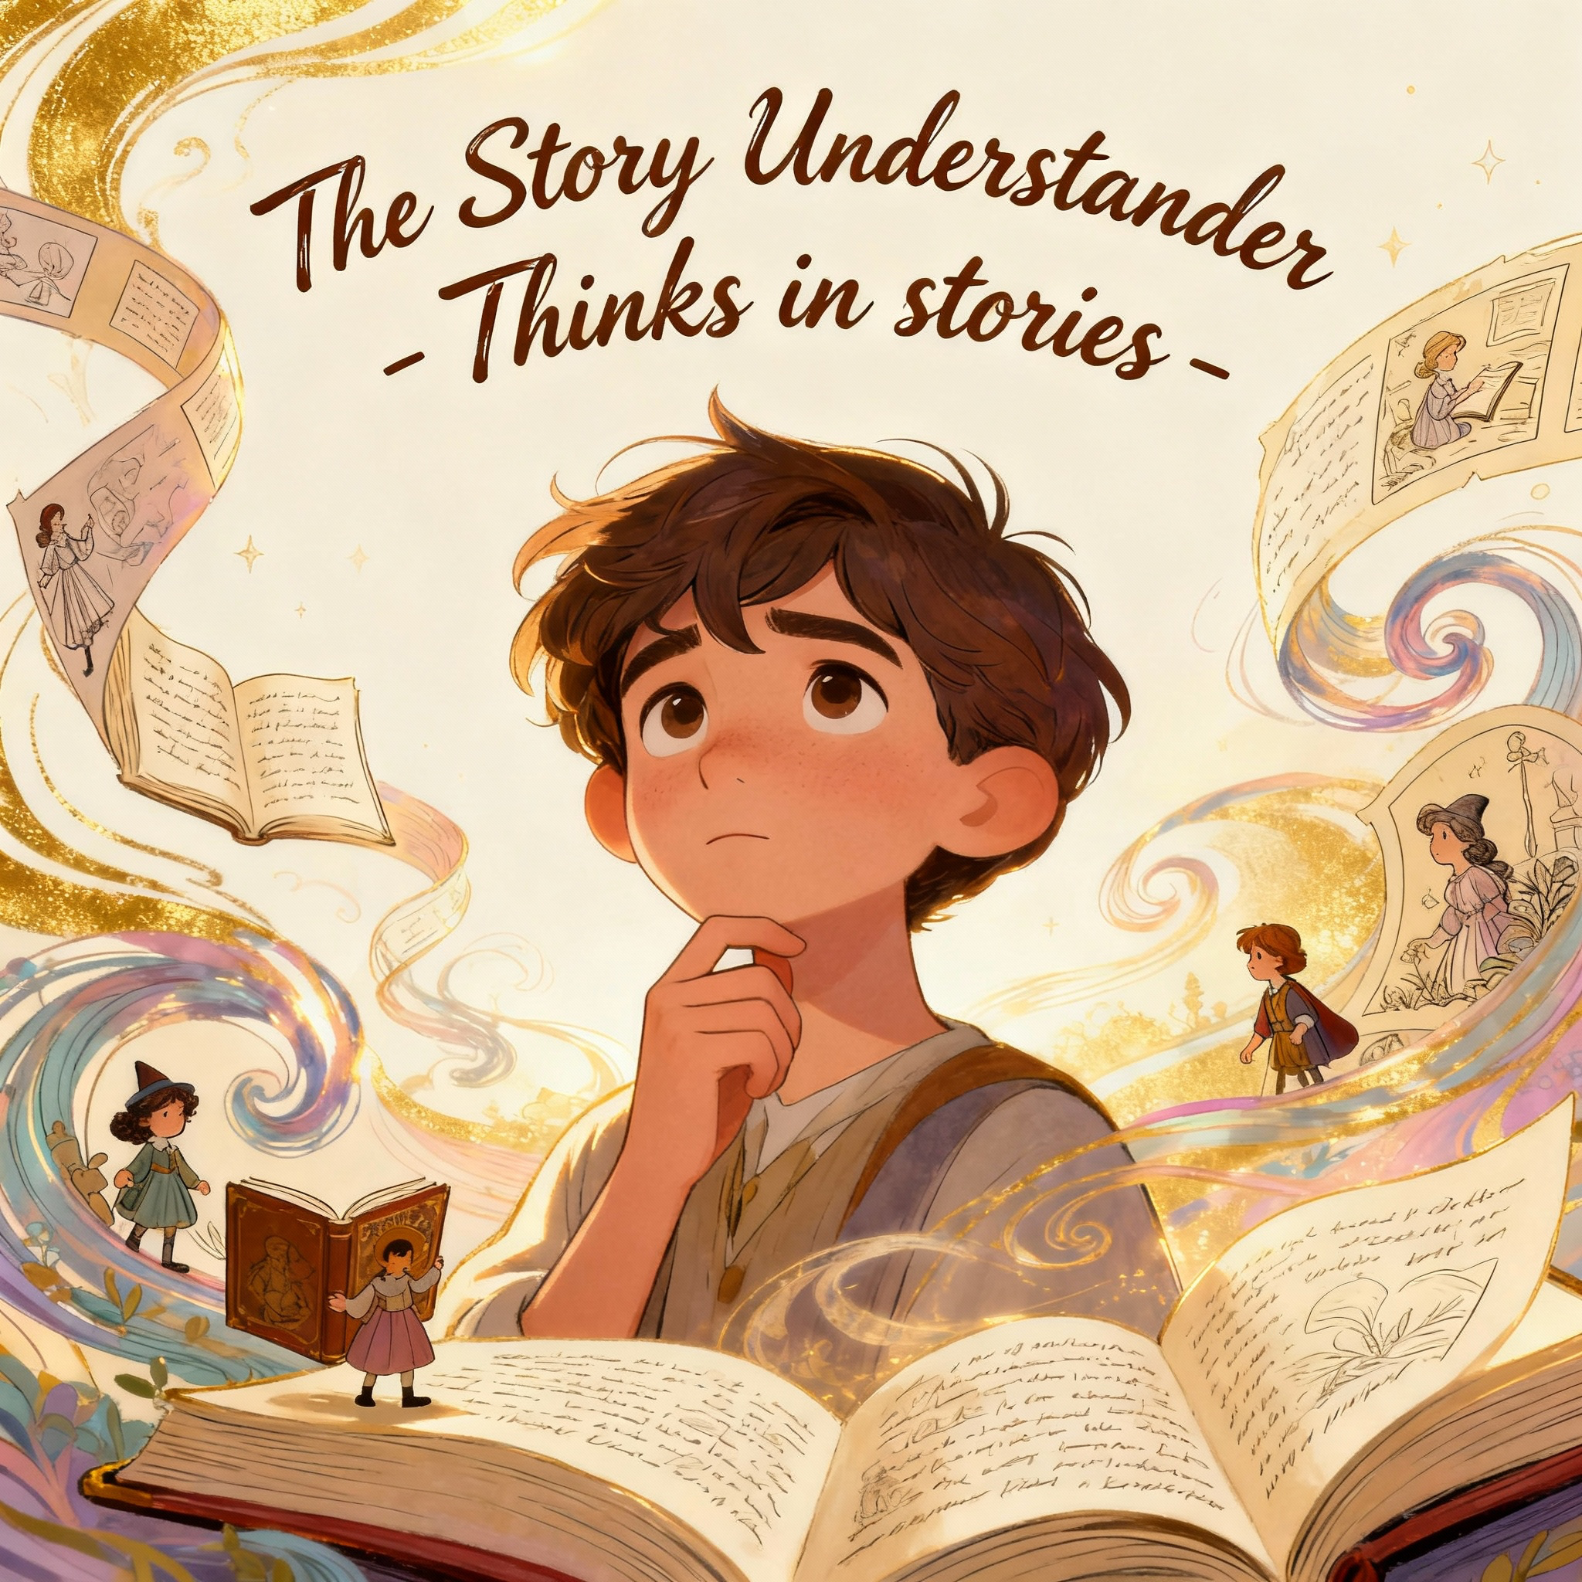
Logistic Regression and DistilBERT
Insight - Model
Keyword Uniqueness
Narrative Dominance

Slide 17
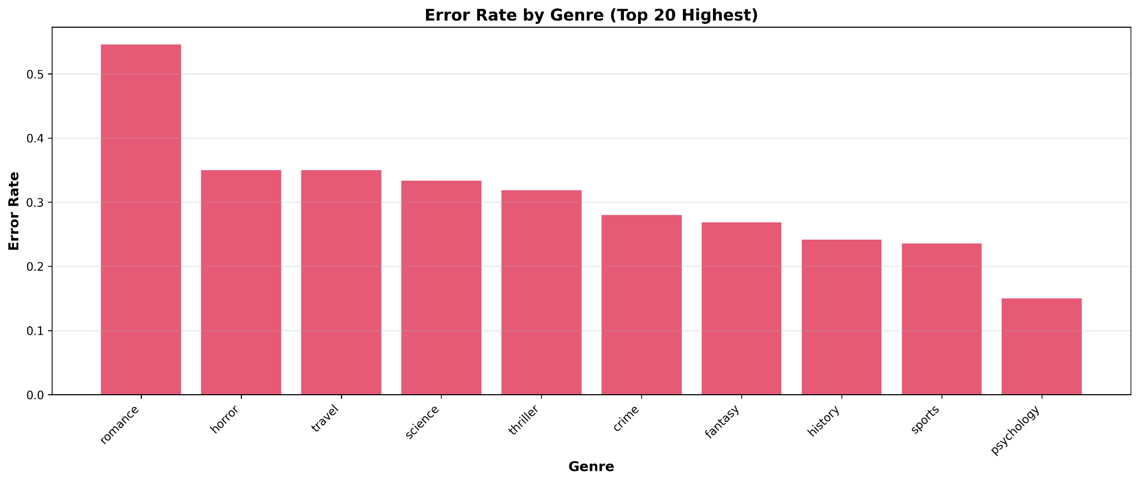
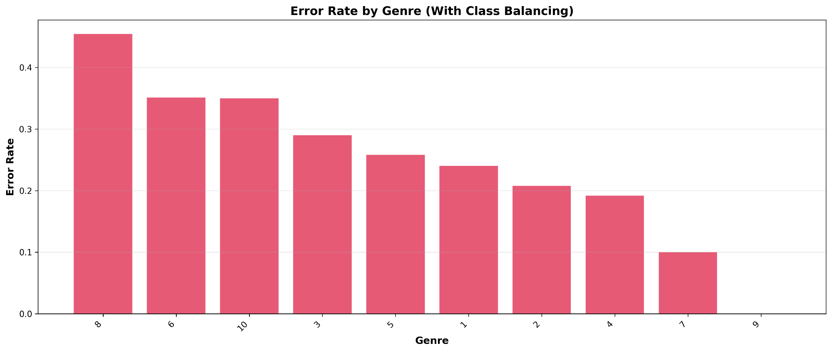
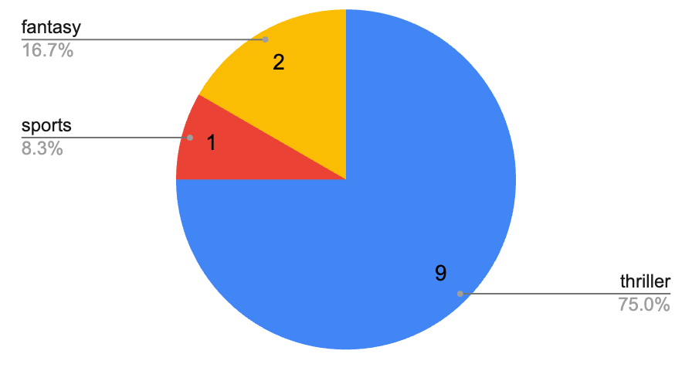
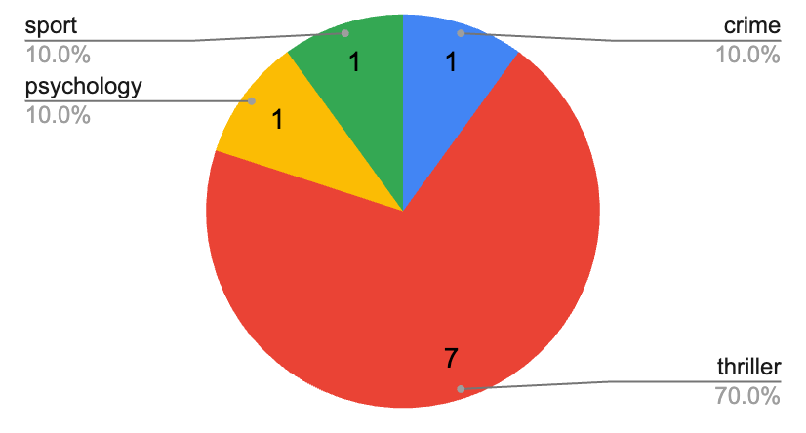
Why Romance is a hardest genre to predict ?
Insight - Model Pattern
LogReg
DistilBERT
Romance as minority class
Error chart shows that both model very weak at predicting Romance
Root cause :
Romance as a genre is easily combined with another genre
As minority class, if the actual data is dominated by borderline genre, the synthetic sample also will further multiply them.
Note :
Even when both model wrong, DistilBert makes overly confident prediction (at least 0.75), meanwhile LogReg is more cautious (max 0.45)
The mistakes majority comes from Romance wrongly predicted as Thriller

Slide 18
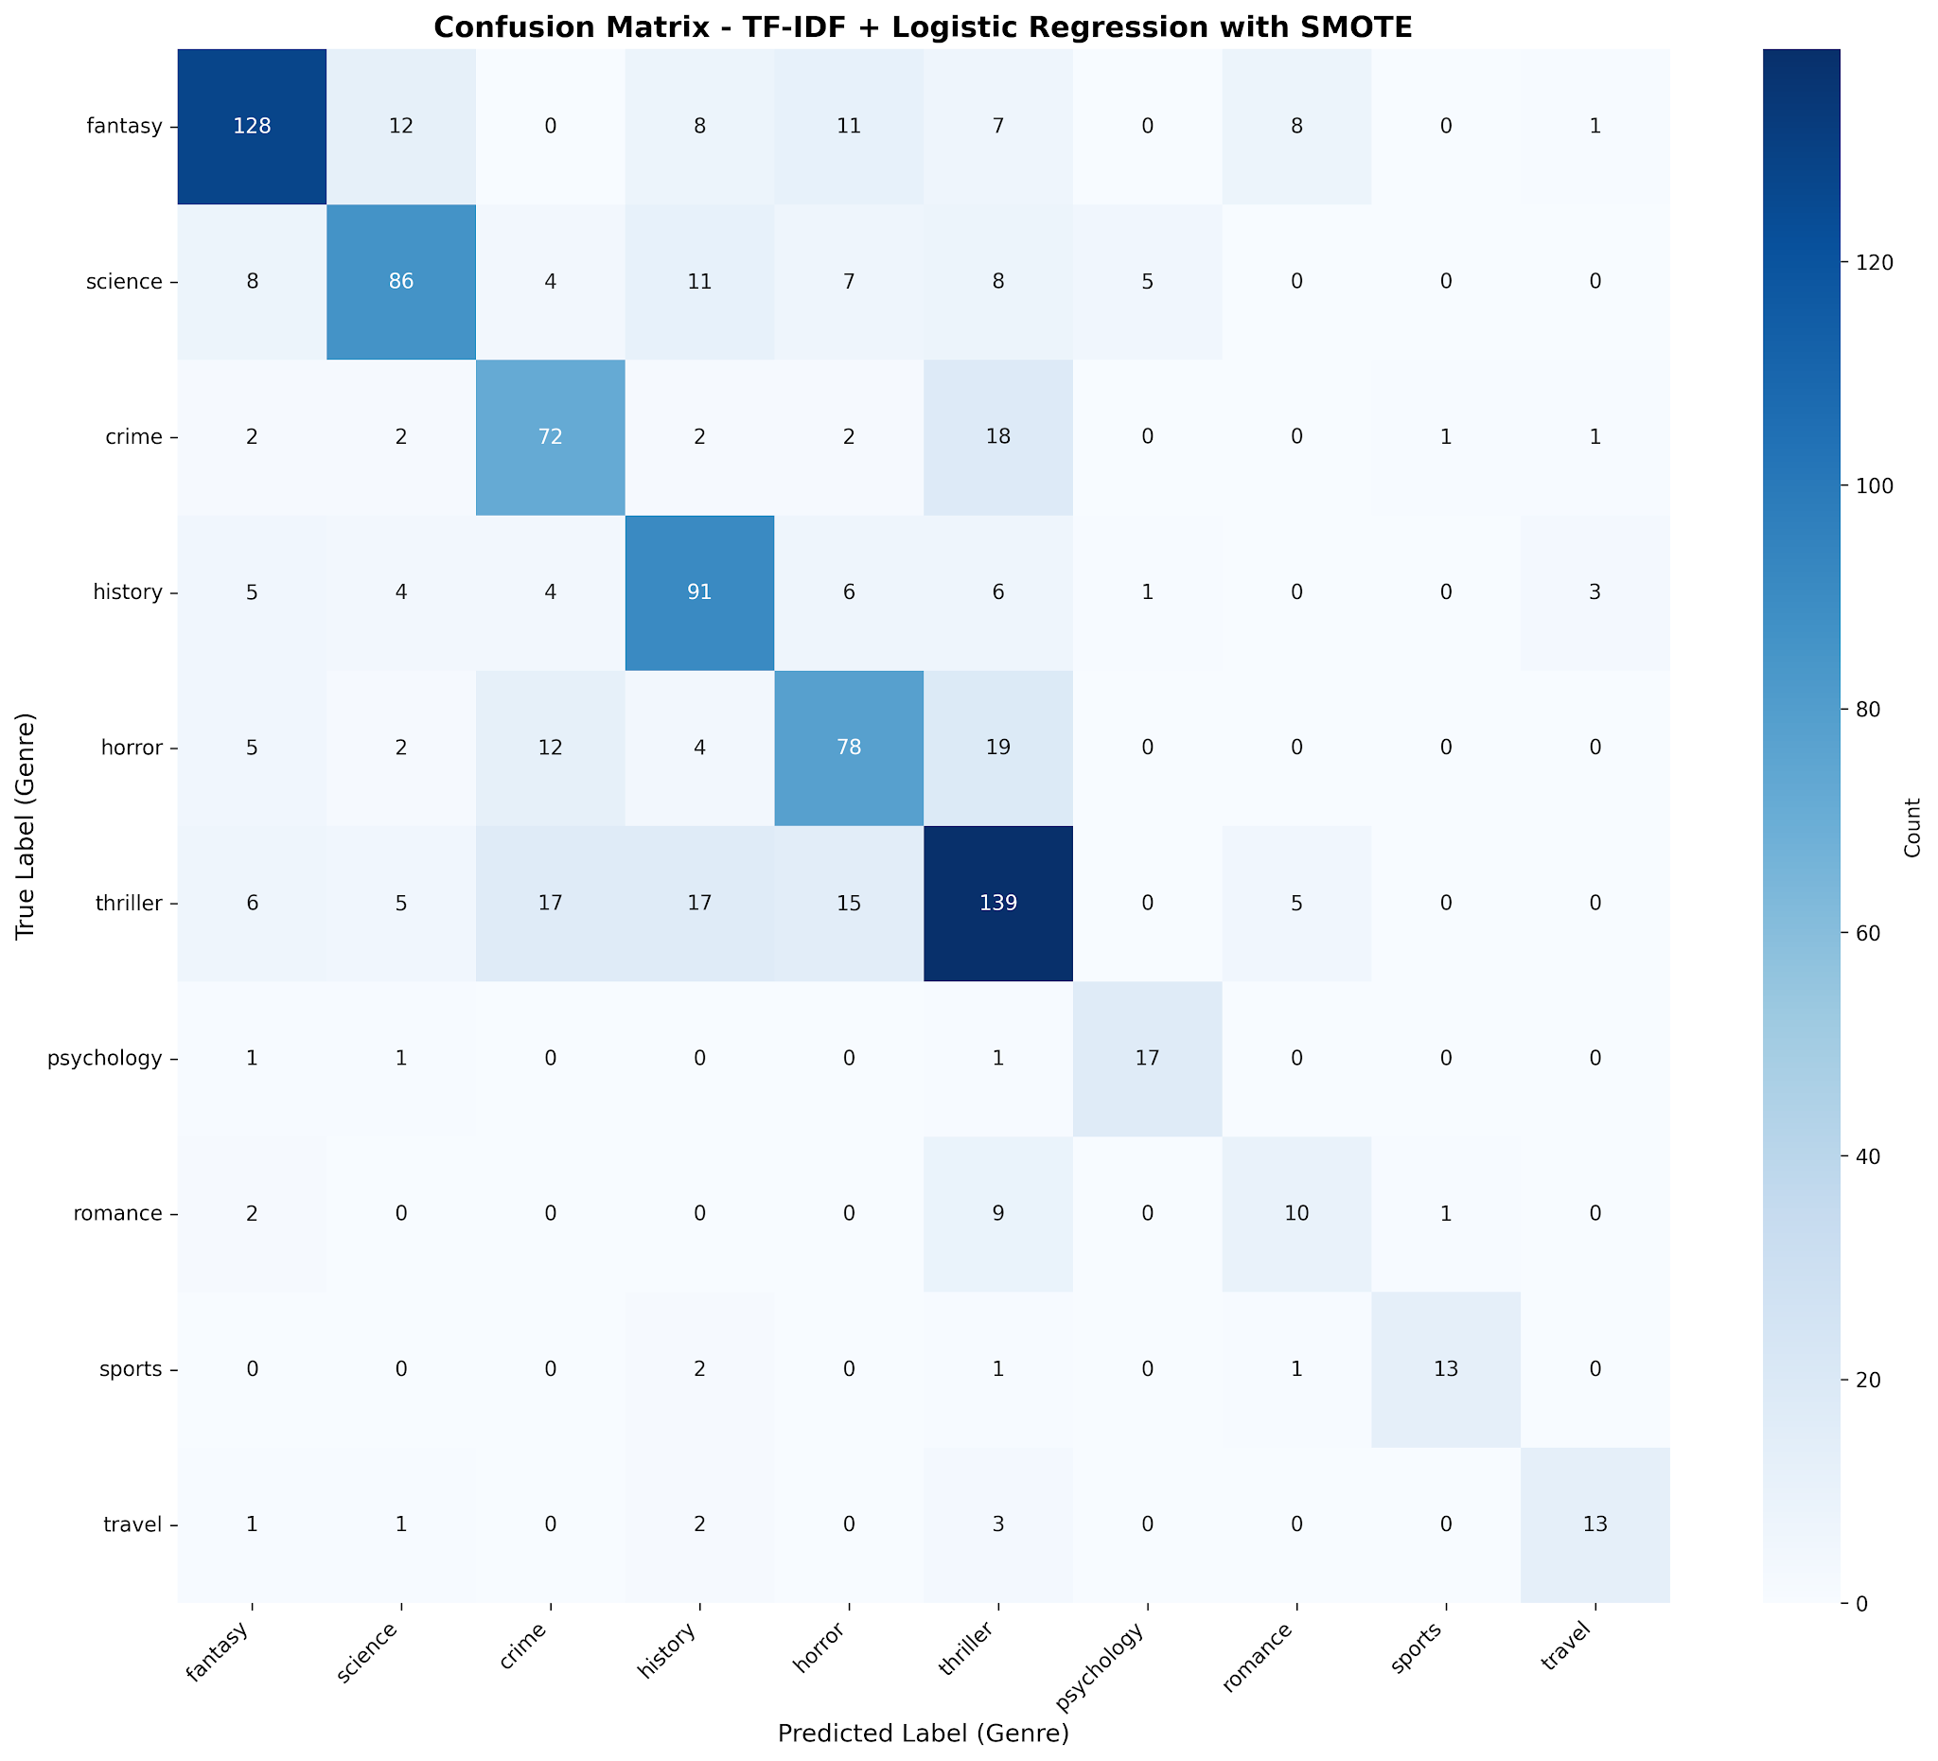
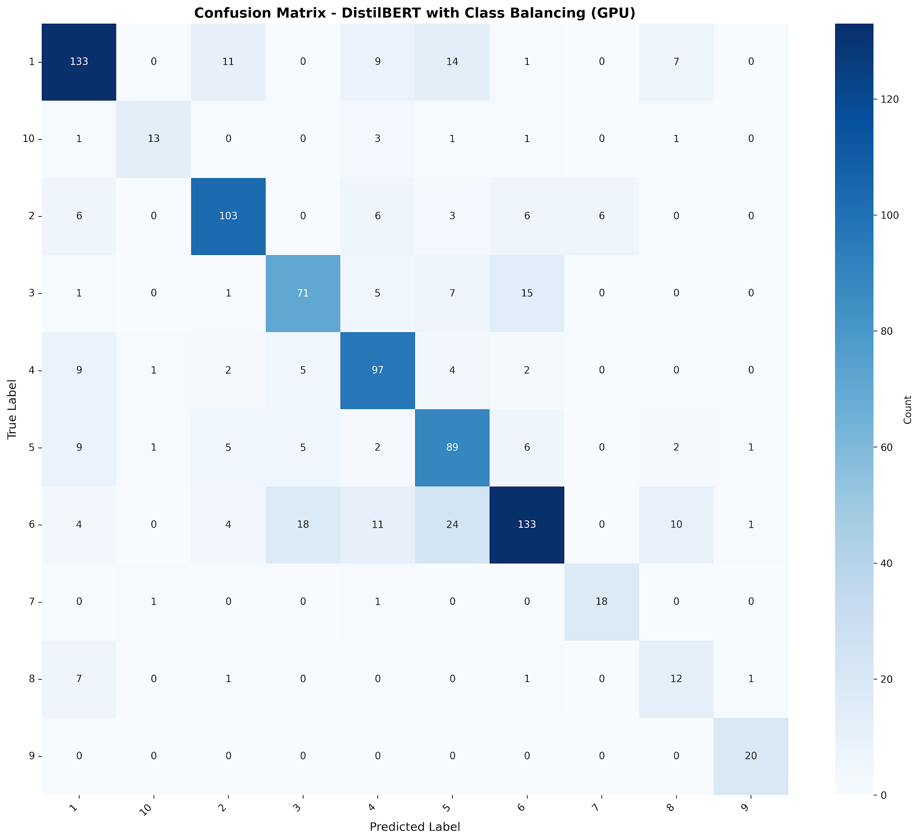
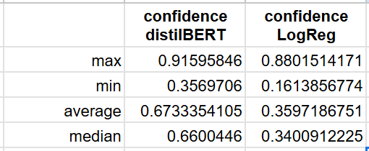
Confused Group : Crime - Thriller - Horror
Insight - Model
distilBERT two times overconfident compare to LogReg
LogReg
DistilBERT
Rootcause :
Nature of the genre is very similar.
Recommendation :
Might need more training especially on borderline
Or consider genre “Suspense”, and all the original three as sub-genre
Confusion matrix shows evidence of these three confused group
Overlap keyword extracted from LogReg :
| murder | case | investigation | detective | killer | suspense | suspect | kill | horror | thriller |
Though distilBERT more superior in understanding context, it only contribute slight improvement in predicting these three genre

Slide 19
Recommendation
Conclusion
Refer back to evaluation scenario :
Scenario A: User Inputs Synopsis, Get output Genre
Scenario B: User input Genre, get book Recommendation
Precision Important !
Winner: DistilBERT (0.75 precision) vs LogReg (0.70 precision)
Impact: Users receive fewer wrong genre assignments
Recall Important !
Winner: DistilBERT (0.74 recall) vs LogReg (0.70 recall)
Impact: Users discover more relevant books
Recommendation :
Provide more balanced training data to DistilBERT model , so it can achieve better precision especially for borderline genre.
Example :
User input synopsis for “Twillight” , output will show genre : Romance
Recommendation :
Allow 1 book classified into multiple genre. To implement this, better to use LogReg because it is more sensitive of genre ambiguity.
Example :
Book “Twillight” can appear twice when user search Genre Romance or Fantasy.

Slide 20




What We Learned
Conclusion
Data Cleaning Complexity
Finding Balance
Traditional ML Still Competitive
Data Cleaning process is very complex, iterative, also labour intensive. Combination of visual inspection, data audit, and built-in from vectorization are crucial to this stage.
We initially thought that model development is all about accuracy. But, there is a lot of component to balance in it, such as training time, resource.
Logistic Regression achieved 70% accuracy with high interpretability and efficiency, proving simple models remain valuable benchmarks.
Role of Class Definition
Versioning & Logs
Ton of Options
Effective class definition is crucial even before ML model construction. Evaluate whether classes are sufficiently distinct and consider the condition of actual data. We can not force data to fit into class, but we should decide the proper classification instead, such as multi-label, or hierarchical.
Every adjustment can bring either huge or subtle improvement. The role of clear versioning and logs are essential in any ML development. Improper documentation will result in difficulty in choosing the final model.
To handle classification problem, there are limitless model option to try. Every one of them are designed for specific needs. We should learn the model characteristics before jump in and put the effort.

Slide 21
Questions and Answers

Slide 22
Thank you

Slide 23
Architecture Comparison - What Works and Why
Insight - Model
Aspect | Logistic Regression | DistilBERT
Feature Type | TF-IDF (sparse) | Contextual embeddings
Context Handling | Bag-of-words | Bidirectional attention
Sequential Info | Lost | Preserved
Interpretability | High (coefficients) | Low (complex)
Speed | Fast | Slow
Hardware | CPU | GPU preferred
Each model offers distinct trade-offs: Logistic Regression excels in efficiency and interpretability, while DistilBERT delivers superior contextual understanding at the cost of complexity and computational demands.

Slide 24
Logistic Regression: Strengths vs Weakness
Insight - Model: Logistic Regression
Fast and Resource-Efficient | Effective Imbalance Handling | Strong Baseline Performance | Interpretable
Distinctive Vocabulary Patterns
Keyword-Based
Clear Linear Separability
Bag-of-Words Approach | Semantic Blindness | Linear Underfitting
Hybrid Genre Confusion
Semantically Similar Genres
Genuine Uncertainty
No Contextual Leverage

Slide 25
DistilBERT: Strengths vs Weakness
Insight - Model: DistilBERT
Contextual Understanding | Efficient Architecture | Best Overall Performance | Deep Semantic Processing
Perfect Sports Classification
Strong Psychology Performance
Clear Contextual Signatures
Resource Intensive | Limited Interpretability | Small Dataset Constraints | Truncation Information Loss
Weak Romance Performance
Overconfidence in Errors
Contextual Dominance Effect
Insufficient Training Data

Slide 26
Dataset Overview & Challenges
Issue Category | Implication | Action
Major Imbalance | Bias toward majority genres; poor recall and performance for minority classes if not corrected. | SMOTE
Duplicate & Ambiguity Summaries | Contradictory labels undermine model learning, cause lower accuracy and increased uncertainty. | Manually remove
Short/Empty Summaries | Synopsis are sufficiently descriptive, reducing risk of noise from irrelevant entries. | Manually remove
Genre Label Consistency | No unexpected/erroneous genre codes; reliable labeling for classification. | NA
Missing Values | Dataset is complete for critical fields; modeling will not suffer from missing values or need imputation. | NA
Notes:
Dataset Composition
Consists of 4,657 synopses labeled with one of 10 genres including Fantasy, Science, Crime, History, Horror, Thriller, Psychology, Romance, Sports, and Travel. Each book is assigned a single genre despite some having multi-genre characteristics.
Class Imbalance
Certain genres like Psychology, Romance, Sports, and Travel are underrepresented, causing difficulties for models to accurately predict these minority classes.
Genre Overlap & Ambiguity
Genres such as Horror, Thriller, and Crime share similar vocabulary, leading to borderline cases and classification challenges due to overlapping language cues.
Data Quality Issues
Dataset contains anomalies including duplicates, nonsensical words, irrelevant content, missing entries, and highly variable synopsis lengths, all complicating model training and evaluation.
Class Imbalance
Max-to-min ratio of 10.23x; smallest genre = 100 samples, largest = 1023 samples.
Duplicate Summaries & Genre Ambiguity
96 unique summaries have conflicting genre labels among 113 unique duplicate summaries.
Short/Empty Summaries
No summaries found with less than 10 characters.
Genre Label Consistency
All labels are numerical and sequentially consistent:[1–10].
Missing Values
No rows dropped due to missing values in 'summary' or 'genre' columns.

Slide 27
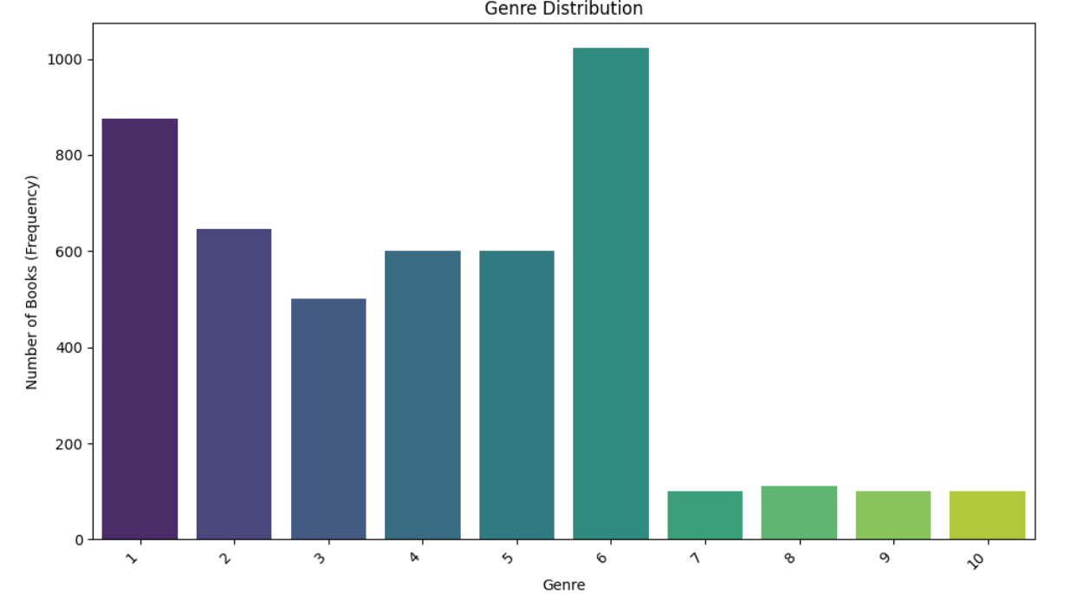
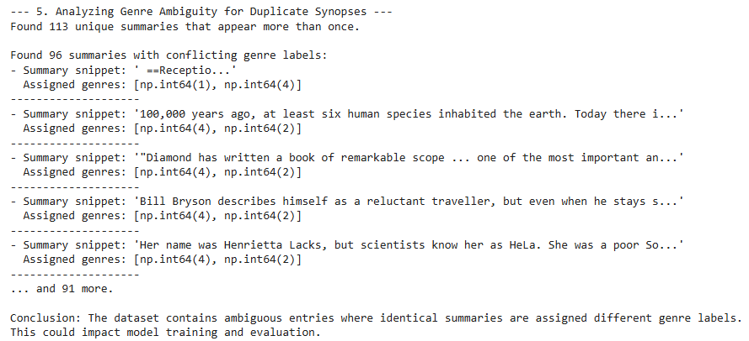
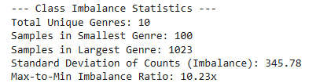
Dataset Overview & Challenges
Dataset
Dataset Composition
Genre Overlap & Ambiguity
Class Imbalance
Notes:
Dataset Composition
Consists of 4,657 synopses labeled with one of 10 genres including Fantasy, Science, Crime, History, Horror, Thriller, Psychology, Romance, Sports, and Travel. Each book is assigned a single genre despite some having multi-genre characteristics.
Class Imbalance
Certain genres like Psychology, Romance, Sports, and Travel are underrepresented, causing difficulties for models to accurately predict these minority classes.
Genre Overlap & Ambiguity
Genres such as Horror, Thriller, and Crime share similar vocabulary, leading to borderline cases and classification challenges due to overlapping language cues.
Data Quality Issues
Dataset contains anomalies including duplicates, nonsensical words, irrelevant content, missing entries, and highly variable synopsis lengths, all complicating model training and evaluation.

Slide 28
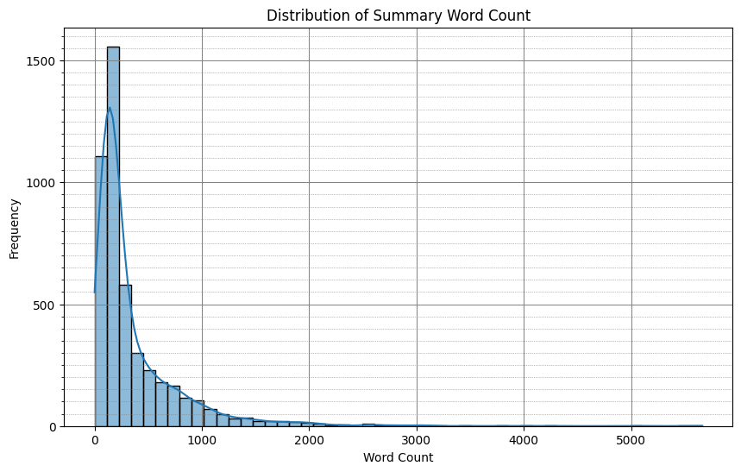
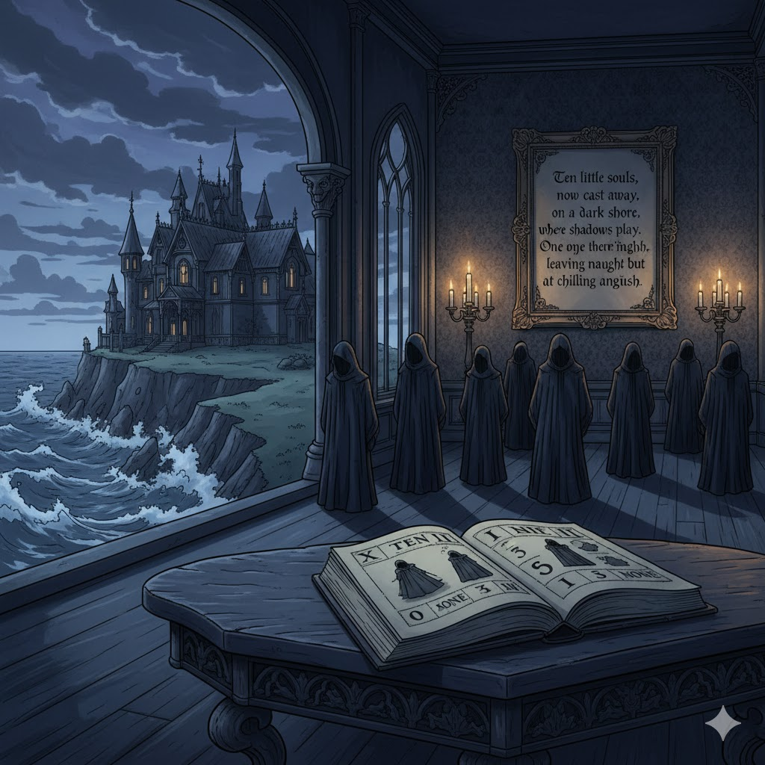


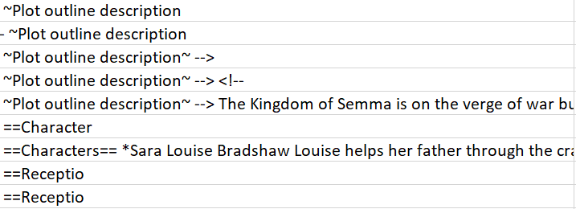
Key Challenges - Data Quality
Dataset Overview
Sample 3358 - Romantic
Extreme Length Variability
Mislabeled Data
Synopses vary from a single word that is meaningless for determine a genre to over 5000 words, complicating text normalization and model input consistency.
Manual review uncovered numerous labeling errors, reducing training reliability and limiting achievable model accuracy.

Slide 29
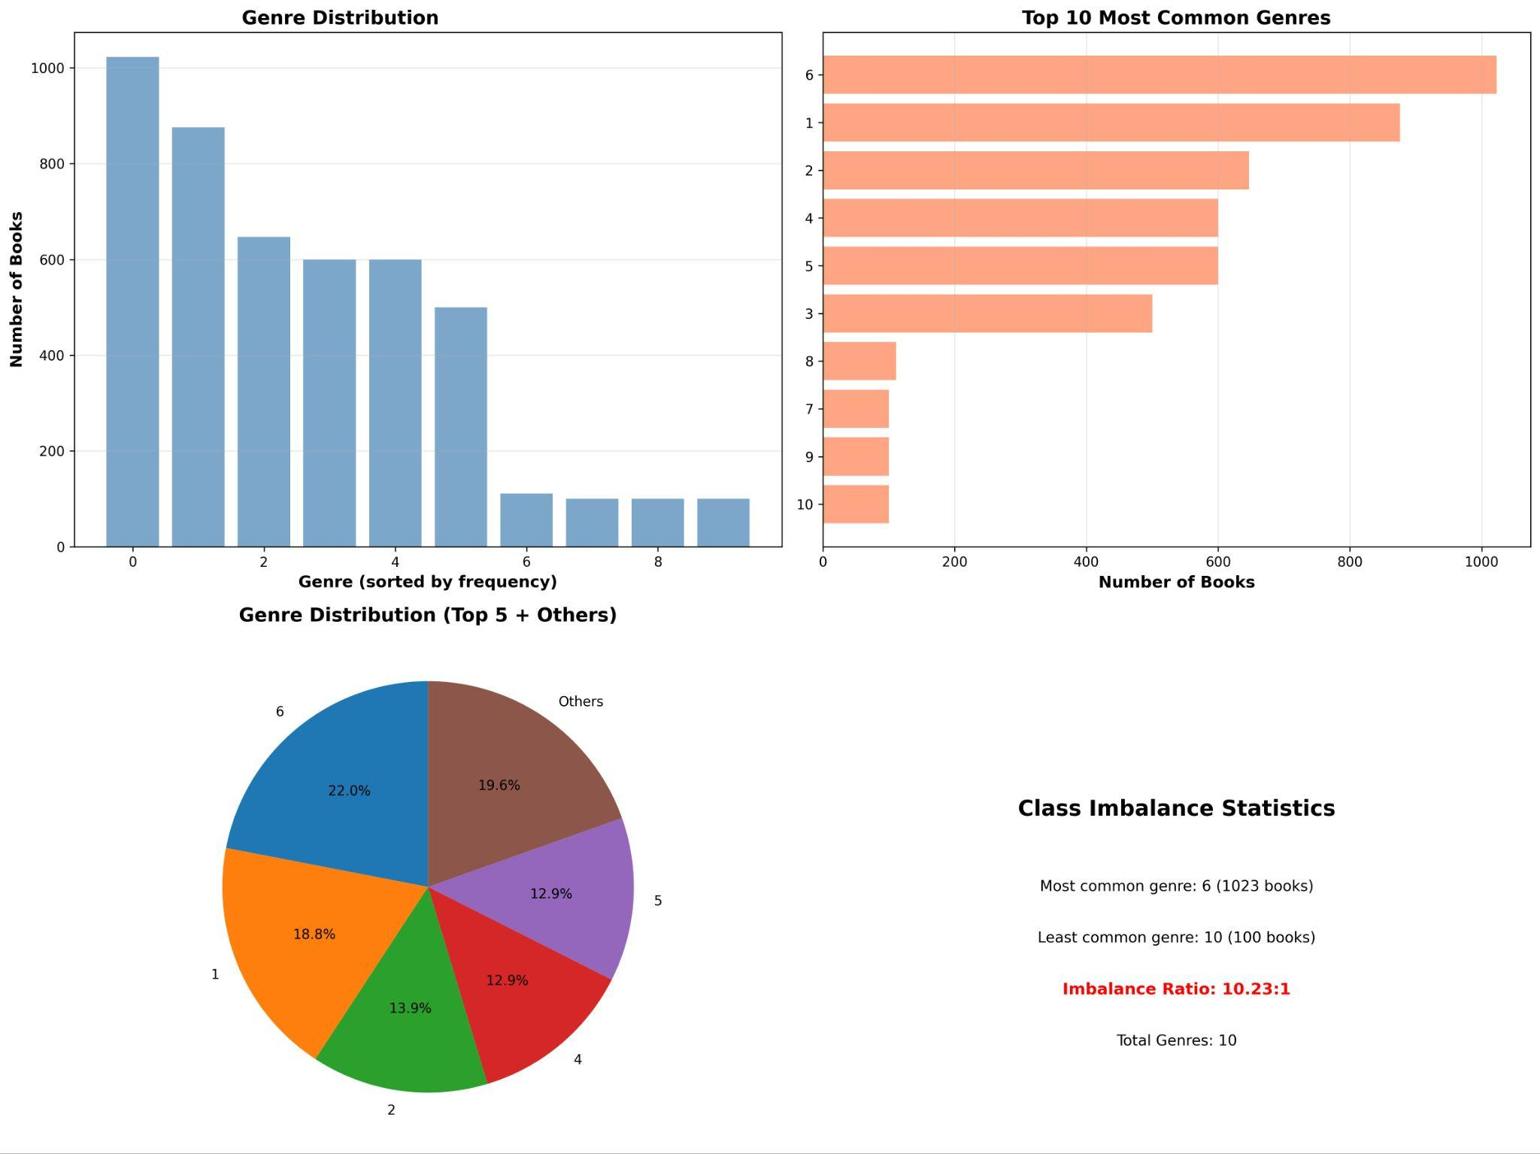

Slide 30
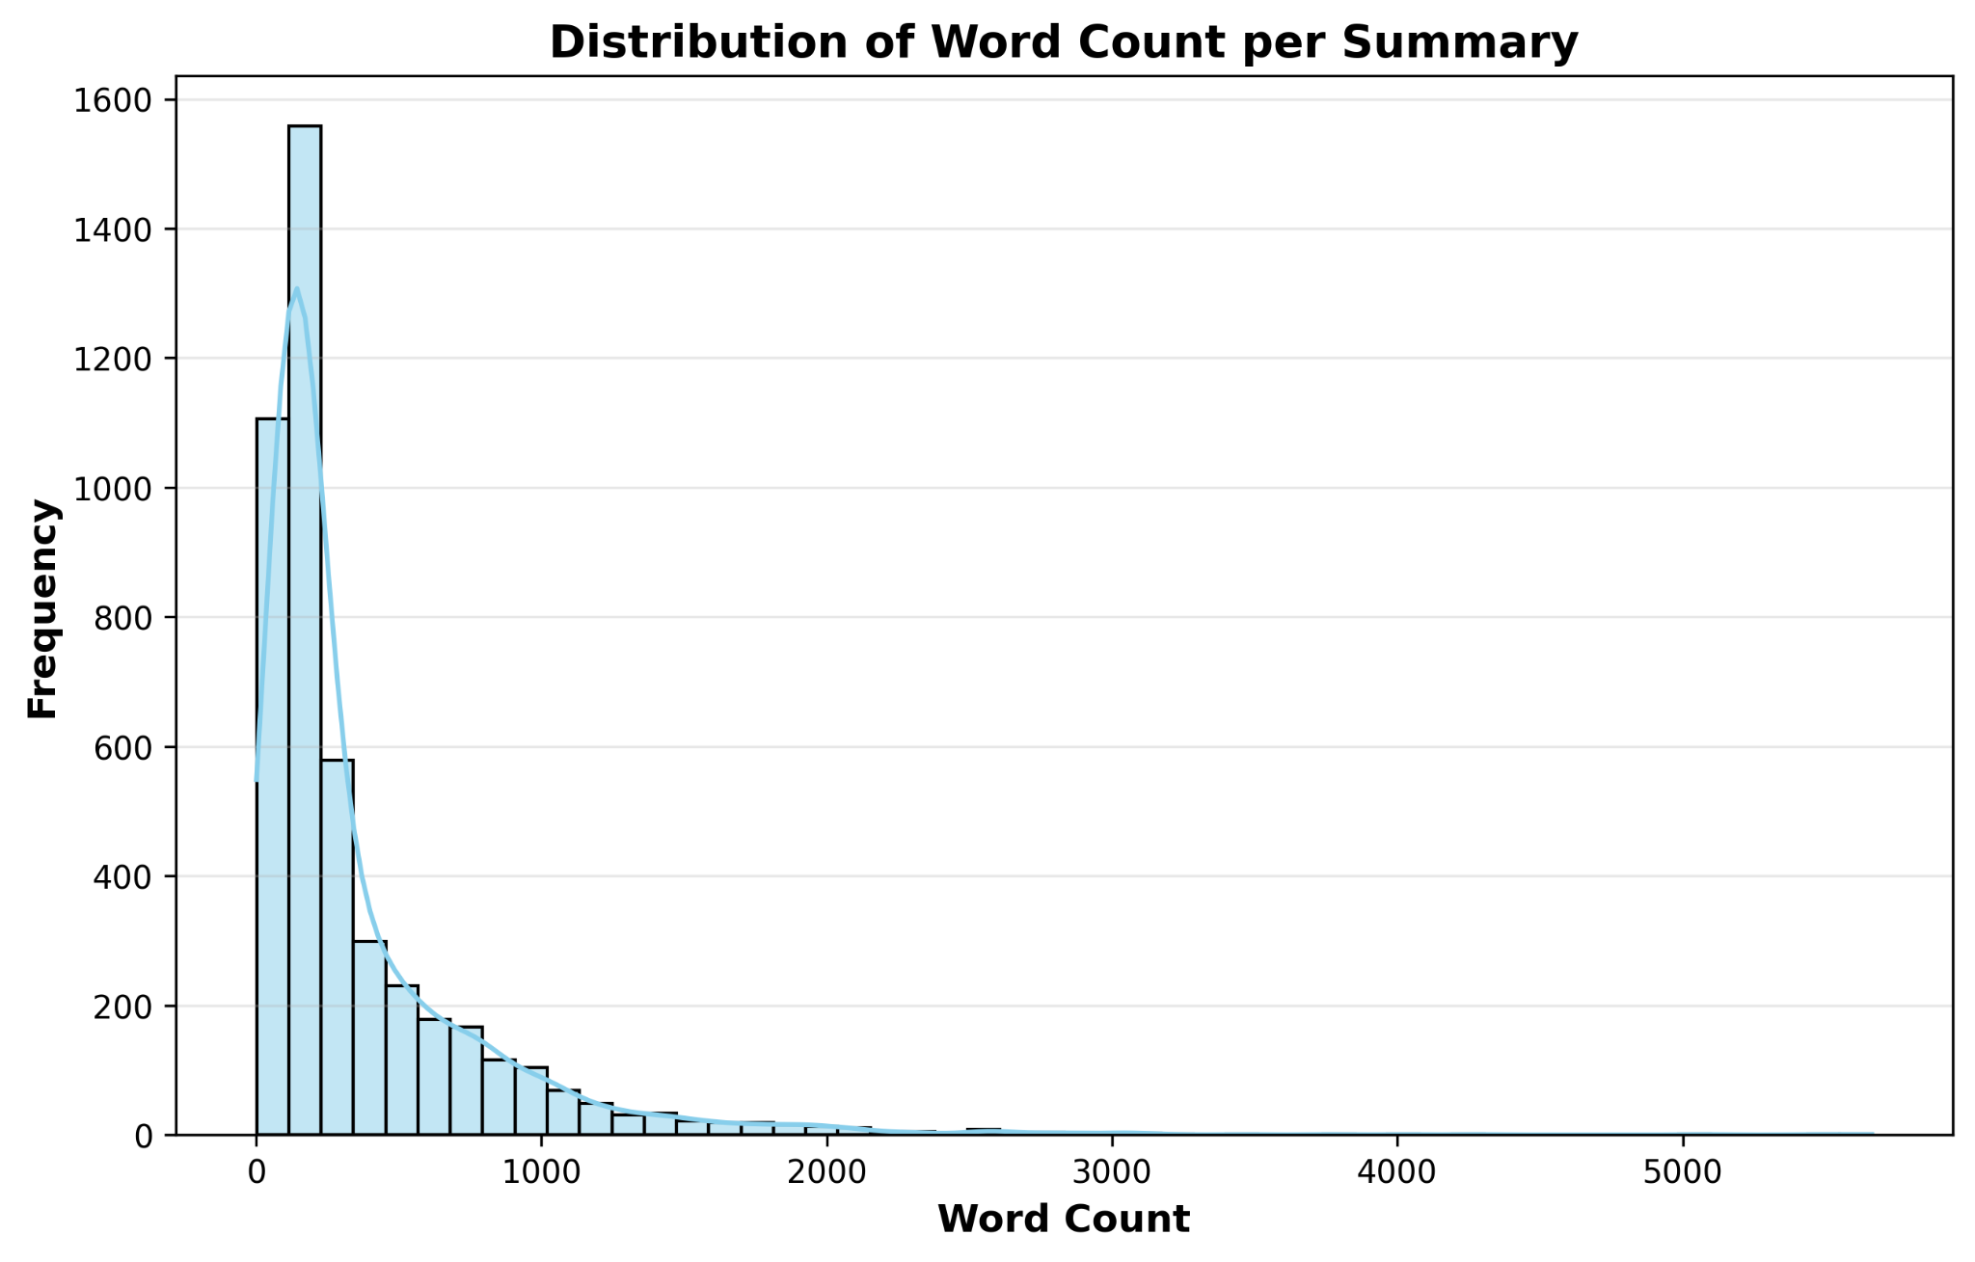
Data Collection
Preprocessing
Visual inspection performed using Excel and text editors.
Identified anomalies such as duplicates, nonsensical words, irrelevant contents, missing entries, and skewed synopsis lengths.
Skewed distribution in synopsis length noted but not truncated to preserve information.
Analyzed genre frequency & distribution.
Inspected word counts per-synopsis for potential outliers or overly short/ long entries.

Slide 31
Logistic Regression: Strengths
Insight - Model: Logistic Regression
Fast and Resource-Efficient
Strong Baseline Performance
No GPU requirements, making it deployable in resource-constrained production environments
Achieved F1-score of 0.70 with stable 5-fold cross-validation results
Effective Imbalance Handling
Interpretable Model
SMOTE improved F1-score from 0.65 to 0.70 (7.7% relative gain) by addressing 10.2:1 class imbalance through synthetic minority oversampling
Inspection of top-weighted words per genre provides transparency in decision-making, valuable for content curators understanding classification rationale
Why It Excels in Specific Genres
Distinctive Vocabulary Patterns: Psychology (85% F1), History (76% F1), Sports (77% F1)
Keyword-Based Advantage: TF-IDF vectorization effectively captures genre-specific terminology that serves as reliable classification signals
Clear Linear Separability: Decision boundaries effectively separate genres when distinctive term patterns exist

Slide 32
Examples - Log Reg
Insight - Model: Logistic Regression
Concrete Example 1 - Sports Genre Success
Synopsis: "Jason awakens on a school bus... Storm Spirit... sword... battle... flying chariot... Camp Half-Blood... demigod children... son of Hephaestus, daughter of Aphrodite, son of Zeus... quest to rescue Hera... fight the giant Enceladus... Wolf House..."
Why LogReg Succeeds: Contains genre-specific keywords like "sword," "battle," "quest," "giant," "flying," "rescue" that strongly signal Fantasy genre through high TF-IDF weights
Research Support: TF-IDF measures word significance by calculating term frequency × inverse document frequency, giving high weights to distinctive genre keywords while downweighting common words
Concrete Example 2 - Psychology Genre Success
Synopsis Context: Books with terms like "mental," "therapy," "consciousness," "behavior," "emotional," "psychological" receive high TF-IDF weights
Why LogReg Succeeds: Psychology genre has highly distinctive technical vocabulary that rarely appears in other genres, creating clear linear separability

Slide 33
Logistic Regression: Weakness
Insight - Model: Logistic Regression
Core Limitations
Bag-of-Words Approach: Ignores word order and sequential context, treating text as unordered term collections
Semantic Blindness: Cannot understand synonyms (e.g., "battle" vs "combat" treated as distinct) or polysemy (words with context-dependent meanings)
Linear Underfitting: Linear decision boundaries cannot capture complex, nuanced text patterns distinguishing similar genres
Why It Underperforms in Specific Genres
Hybrid Genre Confusion: Romance + Sports/Fantasy/Thriller misclassified as dominant non-romance genre due to keyword overlap
Semantically Similar Genres: Confusion between Thriller/Horror and Science/Psychology where shared vocabulary creates ambiguity
Genuine Uncertainty: Lower confidence (0.38) on incorrect predictions reflects recognition of boundary cases with competing keywords from multiple genres
No Contextual Leverage: Cannot distinguish genres beyond surface-level keyword matching, missing subtle semantic differences

Slide 34
DistilBERT: Strengths
Insight - Model: DistilBERT
Contextual Understanding
Best Overall Performance
Processes word order, semantic relationships, and polysemy through transformer self-attention mechanisms
F1-score of 0.74, achieving twice as many correct high-confidence predictions compared to LogReg
Efficient Architecture
Deep Semantic Processing
66 million parameters, 40% smaller and 60% faster than BERT-base while retaining 95% of its performance
Captures nuanced patterns beyond simple keyword matching through bidirectional contextual embeddings
Why It Excels in Specific Genres
Perfect Sports Classification: 100% F1-score achieved through understanding distinctive contextual usage of sports-specific terminology
Strong Psychology Performance: 91% F1-score by capturing nuanced semantic patterns and context-dependent language
Clear Contextual Signatures: Excels when genres have distinct contextual markers requiring understanding of word relationships and sentence structure

Slide 35
Examples - DistilBERT
Insight - Model: DistilBERT
Concrete Example 1 - Fantasy Success
Bidirectional attention captures narrative structure and mythological context—"son of Zeus," "daughter of Aphrodite," "satyr," "quest" form coherent Fantasy semantic network
Self-attention mechanism weighs relationships between "Zeus," "Hephaestus," "Aphrodite" (Greek mythology) and "quest," "rescue," "giant" (fantasy adventure narrative)
DistilBERT's transformer encoder creates contextual embeddings capturing semantic content of entire text, not just isolated keywords
Concrete Example 2 - Psychology Genre Deep Understanding
Texts discussing "emotional trauma in childhood affecting adult behavior patterns"
Understands causal relationships ("childhood trauma" → "adult behavior") and temporal context, not just isolated psychology terms

Slide 36
DistilBERT: Weakness
Insight - Model: DistilBERT
Core Limitations
Resource Intensive: Requires GPU and longer training time, increasing deployment costs compared to LogReg
Limited Interpretability: Black-box nature provides no visibility into which features drive predictions, hindering debugging and trust
Small Dataset Constraints: 367 samples/class falls on the lower end of recommended ranges (hundreds to thousands) for optimal transformer fine-tuning
Truncation Information Loss: 512-token maximum limit causes loss of information for longer synopses (dataset range: 15-663 words)
Why It Underperforms in Specific Genres
Weak Romance Performance: 38% F1-score because romantic elements appear embedded within other genre contexts (fantasy romance, sports romance)
Overconfidence in Errors: Makes 3x more incorrect high-confidence predictions (0.68 confidence) than LogReg, indicating poor probability calibration
Contextual Dominance Effect: Mixed-genre scenarios where Romance combines with Sports/Fantasy/Thriller cause model to prioritize dominant genre's contextual signals over relational language markers
Insufficient Training Data: Dataset size (3.7k samples total) limits ability to learn complex genre-specific patterns that transformers excel at with larger datasets

Slide 37
Examples - DistilBERT
Insight - Model: DistilBERT
Example 1 - Fantasy-Romance Misclassification (High Confidence Error)
Self-attention mechanism heavily weights Fantasy narrative arc: "troll," "faeries," "magic drug," "swordplay," "duel," "glass sword," "heart restoration" form dominant contextual theme
Transformer encodes sequential narrative structure of fantasy quest (rescue → battle → magical healing) which overwhelms scattered romantic moments ("kiss," "love," "boyfriend")
Transformers capture global contextual dependencies by assigning dynamic weights—when Fantasy elements dominate narrative flow, attention weights favor these patterns
High Confidence Problem: Model assigns 0.68+ confidence to Fantasy classification because contextual coherence of fantasy elements is strong, despite Romance being equally valid label
Concrete Example 2 - Romance in Sports Setting (Misclassified as Sports)
Contextual markers of sports setting ("athlete," "team," "championship," "season") create stronger semantic network than relational language ("love," "romance," "relationship")
Attention Mechanism Issue: Sports terminology appears in structured sequences (training → competition → victory), creating coherent narrative that dominates attention weights

Slide 38
Key Challenges - Data Quality
Challenges
Class Imbalance
Extreme Length Variability
Mislabeled Data
Noisy and Anomalous Entries
Certain genres like Psychology, Romance, Sports, and Travel are underrepresented, causing models to struggle with minority class predictions and reducing overall accuracy.
Synopsis lengths vary widely from a single meaningless word to over 5,000 words, complicating text normalization and creating inconsistent inputs for modeling.
Manual reviews revealed numerous labeling errors, where synopses are incorrectly assigned genres, limiting the model's ability to learn and predict accurately.
Dataset contains duplicates, irrelevant content, nonsensical words, and missing entries, all of which introduce noise and degrade model training quality.
Notes:
https://smith.langchain.com/o/e0e81823-4443-4de7-b7d7-c4f5c81e69f3/projects/p/f927376e-982a-4165-b9b6-e8d6cab0f6a5?columnVisibilityModel=%7B%22outputs%22%3Atrue%2C%22feedback_stats%22%3Afalse%2C%22reference_example%22%3Afalse%2C%22reference_example_id%22%3Afalse%2C%22last_queued_at%22%3Afalse%2C%22id%22%3Afalse%2C%22in_dataset%22%3Afalse%2C%22total_cost%22%3Afalse%2C%22first_token_time%22%3Afalse%2C%22tags%22%3Afalse%2C%22metadata%22%3Afalse%7D&timeModel=%7B%22duration%22%3A%227d%22%7D&runtab=2&searchModel=%7B%22mode%22%3A%22raw%22%2C%22query%22%3A%22eq%28tag%2C+%5C%22slide-22d1fa5b-cb7d-4d5f-93ba-4dda4ce8a78b%5C%22%29%22%7D
Retries: 1

Slide 39
Our Three-Model Strategy
Methodology
1
2
3
Traditional ML
As Baseline Model
Intermediate DL Model
Transformer Model
Trade-Offs & Goals
Logistic Regression with TF-IDF features offers an interpretable, efficient baseline model running on CPU. It handles class imbalance with balanced weight and SMOTE.
XGBoost + FastText offers better semantics understanding and more robust on handling noisy data. We expect this model can be run on CPU.
DistilBERT fine-tuned for classification captures context and semantics bidirectionally. Achieves highest accuracy but requires more compute resources (GPU)
Balancing accuracy across different class and computing cost. This approach clarifies how complexity impacts performance and guides model choice for deployment.
Interpretable coefficients
Baseline accuracy (~70%)
Fast training and prediction (6s training)
Class imbalance handling
Semantics understanding
Better handling noisy data
Should be able run on CPU
Attention visualization
Fine-tuning setup
72%+ accuracy
Better ambiguity handling
Accuracy vs complexity
Model selection guidance
Strategy rationale

Slide 40
Confidence Patterns in Classification Models
Result
DistilBERT
Logistic Regression
DistilBERT consistently exhibits higher confidence in its predictions, with an overall confidence score of 0.8.
It achieves twice as many correct high-confidence predictions compared to Logistic Regression (LogReg), particularly noticeable in genres with distinct semantic cues like Sports.
Conversely, DistilBERT makes three times more incorrect high-confidence predictions (confidence 0.68) than LogReg.
These errors frequently arise in mixed-genre scenarios, especially when Romance is combined with genres such as Sports, Fantasy, or Thriller.
LogReg is cautious with borderline cases, showing lower confidence due to detecting keywords from multiple genres and weighing the dominant one.
Incorrect LogReg predictions have a lower average confidence of 0.38, reflecting conservative uncertainty.

Slide 41



General Characteristics
Dataset Overview
4,657 row datasets
10 book genre
fantasy: 1
science: 2
crime: 3
history: 4
horror: 5
thriller: 6
psychology: 7
romance: 8
sports: 9
travel: 10
killer | kill | murder
police | victim | dead
Genre Overlap
Sample 3357 - Romantic Thriller
The definition of several genre like Horror, Thriller, and Crime itself has very similar vocabulary.
Borderline Cases
Books with multi-genre characteristics are forced into single labels, oversimplifying complex genre boundaries.
Synopsys Anomaly
Anomalies on the duplicate, nonsensical words, irrelevant contents, missing entries, skewed synopsys lengths

Slide 42
Evaluation Strategy
Result
Accuracy: Measures overall correctness, representing the percentage of correctly classified books out of all tested.
Precision: Fraction of correctly predicted books among all books assigned a predicted genre, reducing false positives.
Recall: Fraction of correctly identified books out of all actual books in each genre, capturing true positives.
F1-Score: Harmonic mean of precision and recall, balancing both metrics for imbalanced data.
Baseline Comparison: Majority class predictor accuracy sets a minimum benchmark that our models must outperform.

Slide 43
Model Comparison - Metric Selection Strategy
Insight - Model
Scenario B: User Browses by Genre
Scenario A: User Inputs Synopsis
Optimize Recall
Use Case: Content discovery where users explore books within a genre category
Why Recall: High recall minimizes false negatives (missing relevant books), ensuring comprehensive search results
Winner: DistilBERT (0.74 recall) vs LogReg (0.70 recall)
Impact: Users discover more relevant books, improving content coverage and satisfaction
Optimise Precision
Use Case: Direct user queries expecting accurate genre identification
Why Precision: High precision minimizes false positives (incorrect genre labels), critical for maintaining user trust
Winner: DistilBERT (0.75 precision) vs LogReg (0.70 precision)
Impact: Users receive fewer wrong genre assignments, enhancing experience quality
Recommended Approach: Weighted F1-Score
Rationale: Balances precision and recall through harmonic mean, suitable for multi-class classification with imbalanced distribution (10.2:1 ratio)
Weighted Advantage: Accounts for class frequencies, providing fairer evaluation across all 10 genres than macro-averaging
Deployment Decision: Choose metric alignment based on primary use case and business priority
Example-Based Analysis
Fantasy-Romance Book: High recall important to ensure book appears in both genre searches; current models miss Romance label
Pure Psychology Book: High precision critical to avoid misclassification that frustrates users searching specifically for Psychology
F1-Score Balance: Optimizes for neither extreme, suitable for general-purpose genre classification systems

Slide 44
Model Comparison - Identical Pattern
Insight - Model
Critical Insight: Shared Error Patterns Reveal Dataset Constraints
Both models exhibit identical confusion patterns (Thriller/Horror, Science/Psychology, Fantasy-Romance), indicating performance limits stem from labeling ambiguity rather than model architecture
Both misclassify hybrid genres identically, proving many books legitimately fit multiple genres
Key Finding: Marginal 0.04 F1-score improvement by DistilBERT despite significantly greater architectural complexity suggests dataset quality matters more than model sophistication
Example Type | Synopsis Keywords | True Label | LogReg Prediction | DistilBERT Prediction
Fantasy-Romance Hybrid | "faerie boyfriend, troll, magic, sword duel, love, kiss" | Romance | Fantasy (0.42 conf) | Fantasy (0.71 conf)
Pure Sports Fantasy | "Zeus son, quest, rescue, giant, battle, satyr, demigod" | Fantasy | Fantasy (0.89 conf) | Fantasy (1.0 conf)
Psychology Text | "mental health, therapy, emotional trauma, behavioral patterns" | Psychology | Psychology (0.87 conf) | Psychology (0.93 conf)
Reason for Failure: Fantasy keywords dominate TF-IDF; contextual quest narrative dominates attention; both models correctly identify distinct mythological context; both models leverage distinctive technical vocabulary
Why both Models struggle?
LogReg: TF-IDF assigns highest weights to most distinctive terms, causing dominant genre keywords to overwhelm secondary genre signals in feature space
DistilBERT: Self-attention mechanism weights tokens based on narrative coherence; dominant genre creates stronger contextual network that captures attention weights
Solution Needed: Multi-label classification to assign multiple genre labels simultaneously
Strategic Improvements for Future Work
Expand Dataset Size: Target 500-1,000+ samples per class to unlock transformer advantages and improve generalization
Multi-Label Classification: Implement multi-label modeling to address hybrid genres like Fantasy-Romance, allowing books to belong to multiple categories
Probability Calibration: Apply temperature scaling to reduce DistilBERT's overconfidence on incorrect predictions
Synopsis Length Handling: Explore truncation strategies or length normalization to improve consistency for both models
Data Quality First: Improving dataset quality through better labeling (multi-label annotation) and larger samples will deliver greater returns than additional model complexity or hyperparameter tuning

